Slide 1
Individual-Based COVID-19 Social Distancing Simulation
Ava Yang (ty2418), Kerry Hu (wh2453), Xiaoyu Chen (xc2525)

Slide 2

Background
Throughout year 2020, the world is experiencing a pandemic from coronavirus and suffering huge loss from it. Tracing back the case scenarios in different regions, we want to identify the potential ways to mitigate this affection process.
We focus on the social distance policy in New York State and want to simulate the Covid-19 spread dynamics under three strategies: social distance, improve hospital efficiency and release of vaccines.

Slide 3
Data
The data and estimated parameters we used mainly come from the resources below.
JHU Repository: Infectious, recovered, and death cases in New York State
World Population Review: New York State population
MIDAS Research Networks: Estimated parameters
Basic reproduction rate (R0)
Recovery rate (𝛄)
Incubation Period
Reporting Rate (RR)
JHU Repository
Data
Input
World Population Review
MIDAS Research

Slide 4
Baseline Model - SEIR
Simulate the status change situation for each individual based on the status change probability
N (Total Population) = S (Susceptible)+E (Exposed)+I (Infectious)+R (Recovered)
𝜷
𝝈
𝞬
Susceptible
Exposed
Infectious
Recovered
dS/dt = - 𝜷 SN/I
dE/dt = 𝜷 SN/I - 𝝈 E
dI/dt = 𝝈 E - 𝞬 I
dR/dt = 𝞬 I
d/dt = 𝜷 N/I (Probability of changing from S to E)
d/dt = 𝝈 (Probability of changing from E to I)
d/dt = 𝞬 (Probability of changing from I to R)
Population Based
divide each equation by its population
Individual Based

Slide 5
SEIR - DH (Individual Based Simulation)
N (Total Population) = S (Susceptible)+E (Exposed)+I (Infectious)+R (Recovered)+D (Death)+H (Hospitalized)
𝜷
𝝈
Infectious - Mild (95%)
Infectious - Critical (5%)
capacity overload
Death
Susceptible
Exposed
Hospitalized
Recovered
Probability (S to E): 𝜷
Probability (E to I): 𝝈
Status of Infectious - Mild:
Status of Infectious - Critical
H is overloaded:
Status of Hospitalized
Probability (H to D): CDR_h
Probability (H to R): 𝞬_h
Probability (I-Critical to D): CDR
Probability (I-Critical to R): 𝞬_c
Probability (I-Mild to D): MR
Probability (I-Mild to R): 𝞬_m
H is not overloaded:
Probability (I-Critical to H): hospital_rate

Slide 6
SEIR - DHV (Individual Based Simulation)
N (Total Population) = S (Susceptible)+E (Exposed)+I (Infectious)+R (Recovered)+D (Death)+H (Hospitalized)
Two vaccine parameter added: vaccine injection date & vaccine proportion (v%)
At the vaccine injection date, the susceptible population is decreased by the proportion of vaccine injection ratio, leading less people to get infected later
Infectious - Mild (95%)
Infectious Critical (5%)
Infectious - Mild (95%)
Infectious - Critical (5%)
capacity overload
Death
𝜷
Death
𝜷
𝝈
𝝈
Susceptible
(1-v%)
Susceptible
Exposed
Exposed
Hospitalized
Hospitalized
Recovered
Recovered
Vaccine

Slide 7
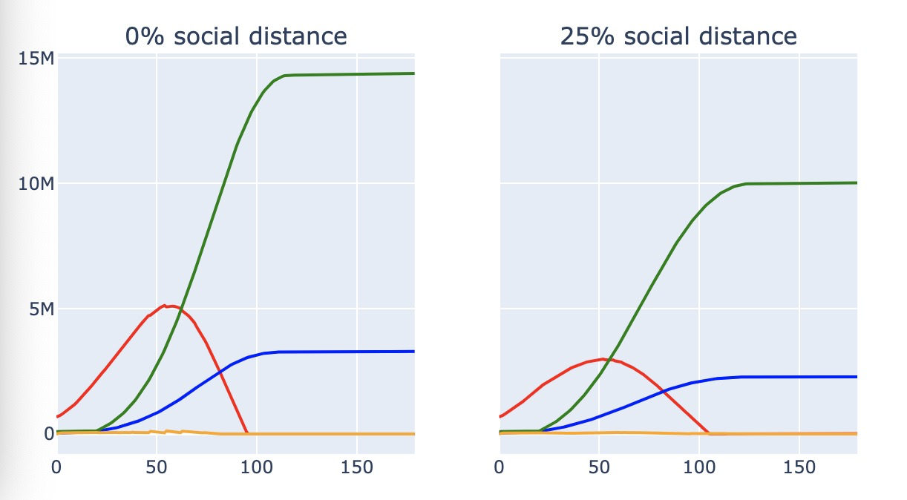
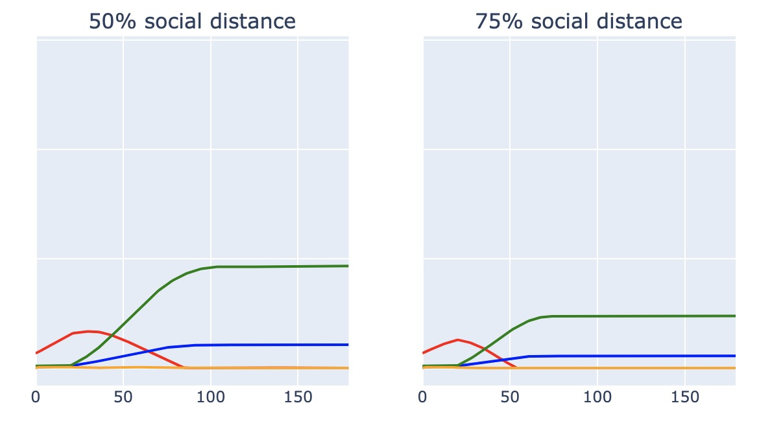
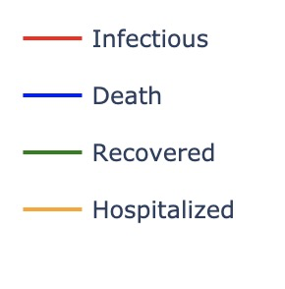
Scenario Simulation - Covid19: Social distance

Slide 8
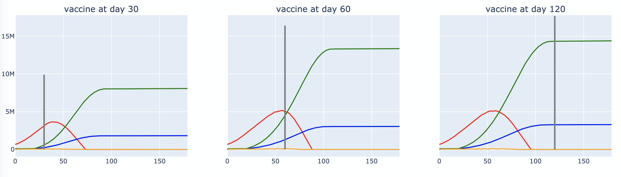
Scenario Simulation - Covid19: Vaccine allocation

Slide 9
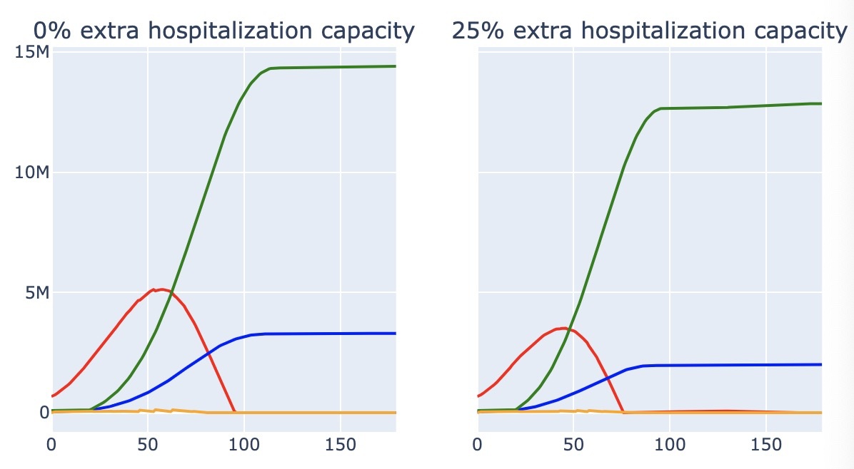
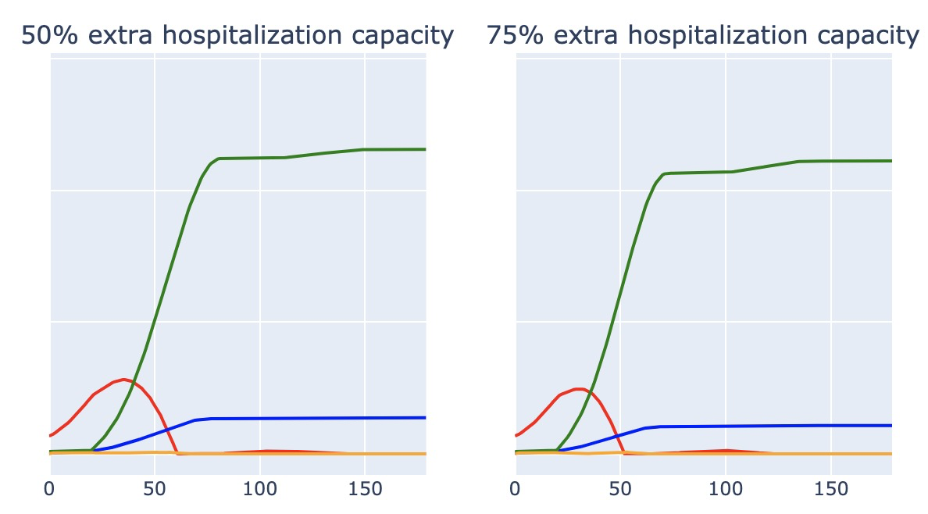
Scenario Simulation - Covid19: Hospital Efficiency

Slide 10
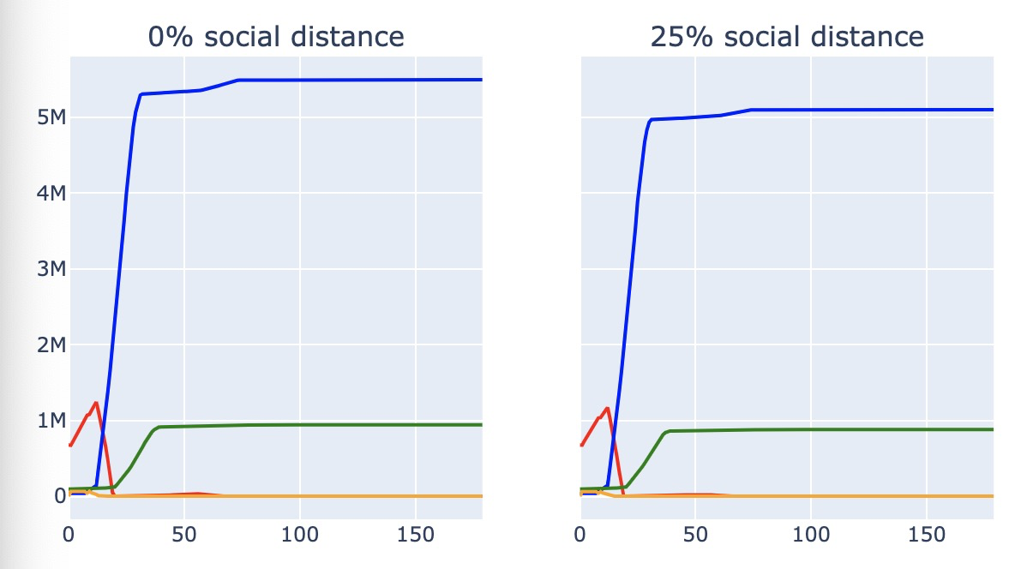
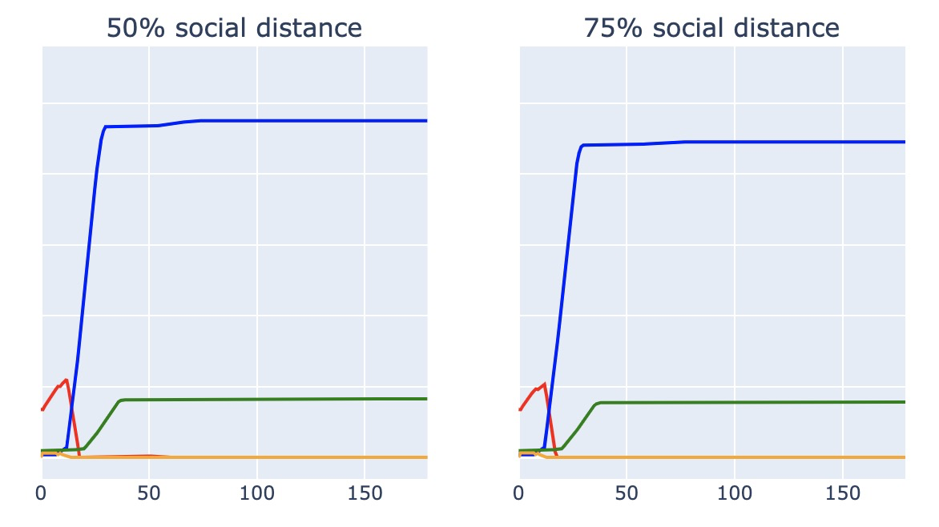
Scenario Simulation - Ebola: Social distance

Slide 11
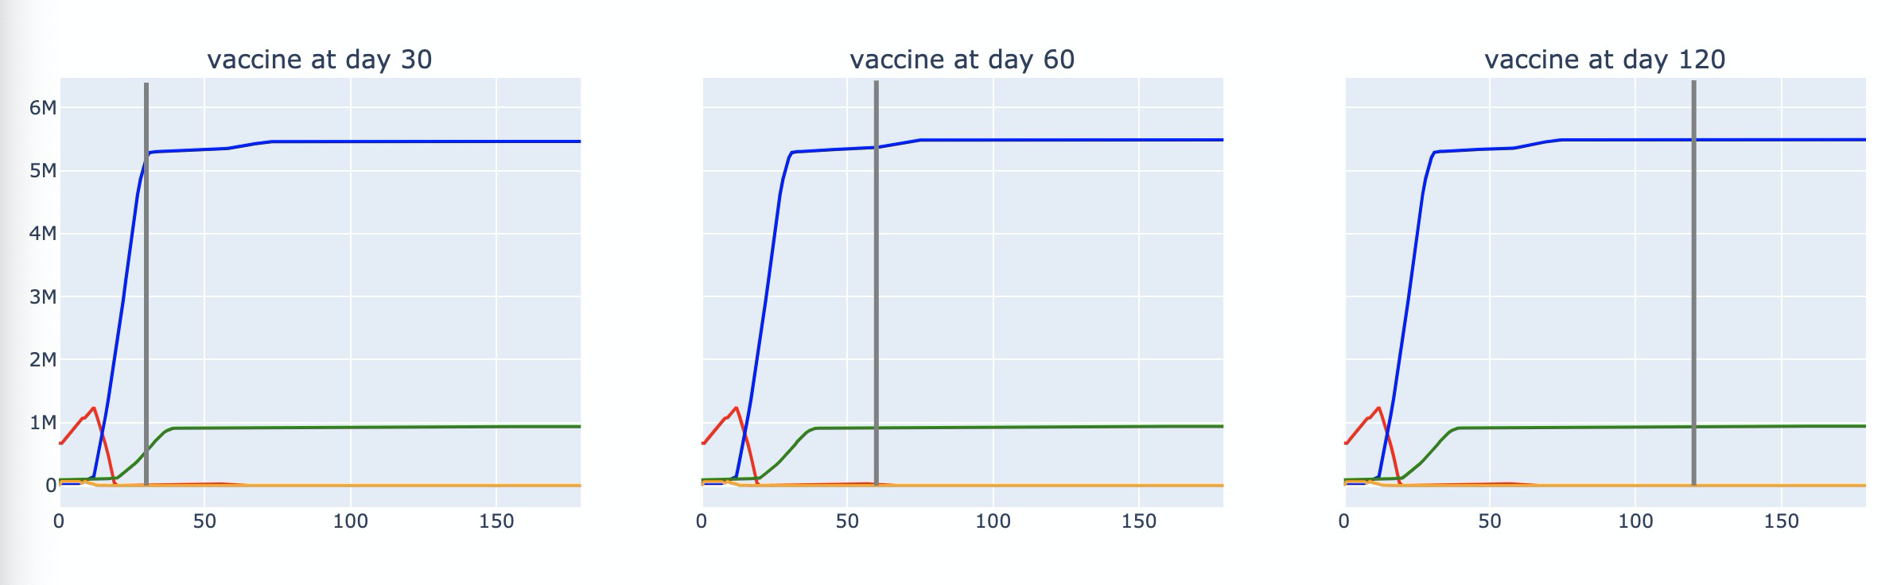
Scenario Simulation - Ebola: Vaccine allocation

Slide 12
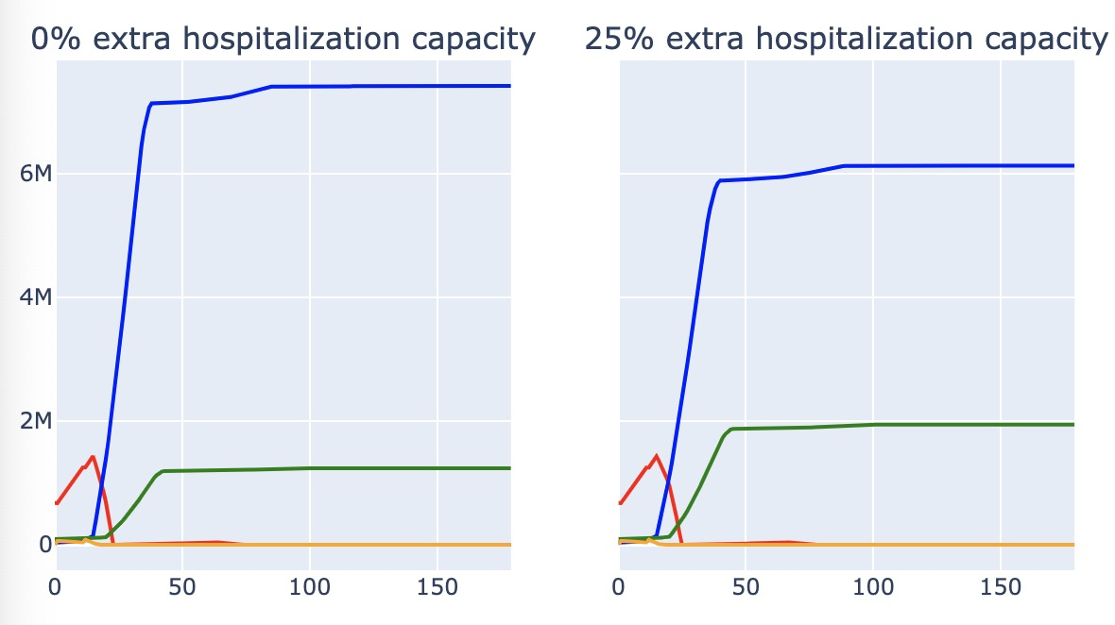
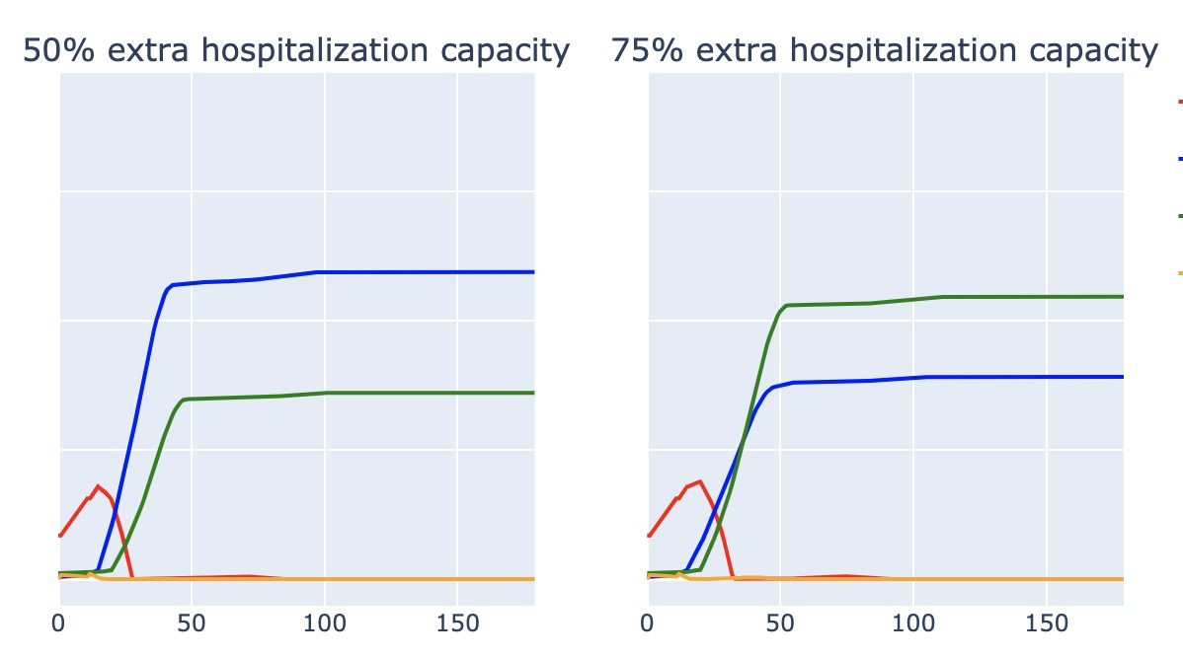
Scenario Simulation - Ebola: Hospital Efficiency

Slide 13
Conclusion
We discussed 3 different policies: social distancing, vaccine allocation, and extra hospitalization capacity.
Among them, optimal policy regarding different virus is distinct:
(1) social distancing is the most effective policy in terms of reducing potential death for Coronavirus, followed by vaccine allocation;
(2) for Ebola, the enlargement of hospitalization capacity tends to work the best for improving the recovery process and controlling fatal death.

Slide 14
Thanks for watching

